Slide 1
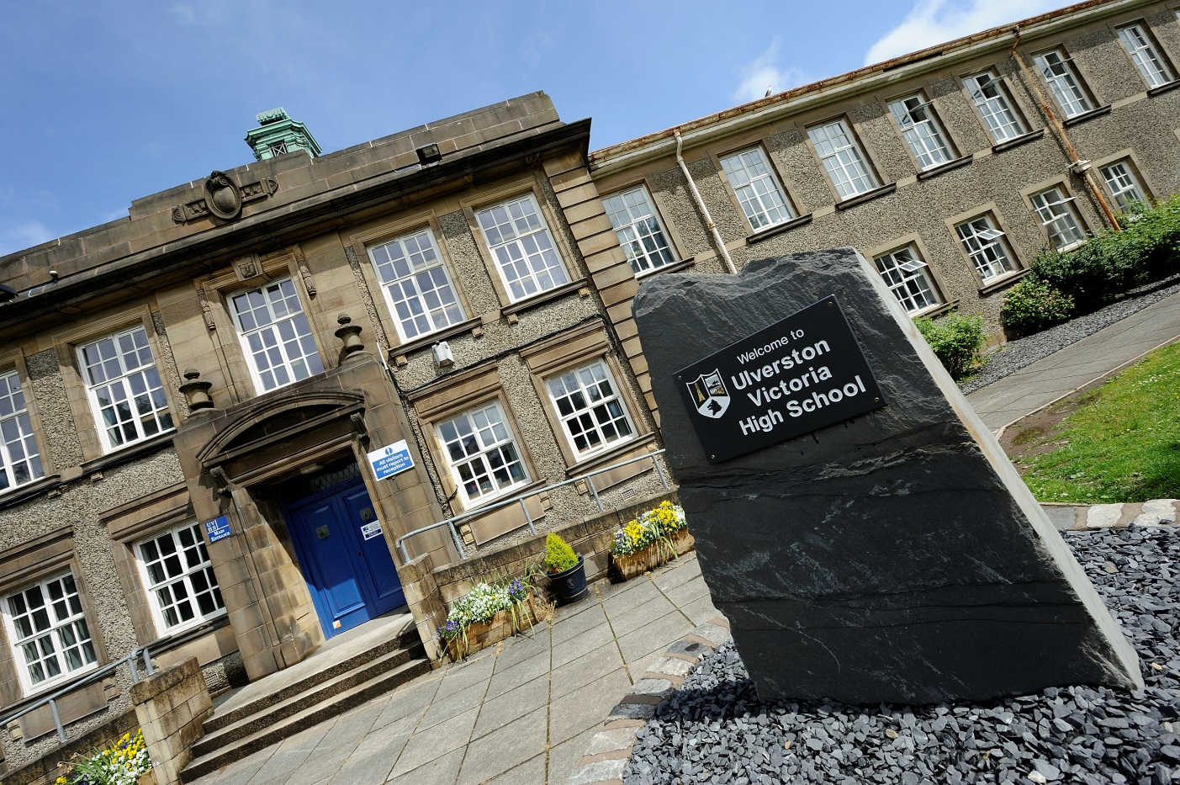
Year 10 Exams Information Evening

Slide 2
Y10 GCSE Preparation Evening
Non-examined assessment (NEA)
Exam regulations
Reviewing and revision techniques
Reducing exam stress

Slide 3
A Partnership
Best results are always achieved when a partnership is formed between student, family and school.
Your support is fundamental to your child’s success.

Slide 4
Important Dates
Y10 Practice Exams | Thursday 18th June – Monday 29th June
Reports | Monday 15th June

Slide 5
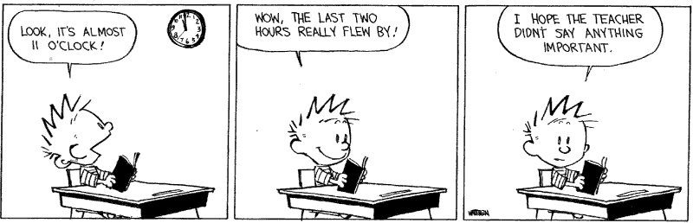
Be Present

Slide 6
Non-examined Assessments
NEA Subjects:
Food Preparation and Nutrition 50%
Drama 40%
Music 60%
Design Technology 50%
Imedia 60%
Sports Studies 60%
Health and Social Care 60%

Slide 7

Mrs Pirate
How much can you remember?
Notes:
Tell partner what you remember
Discuss on your table how you remembered them…

Slide 8

Mrs Pirate by Nick Sharratt
When Mrs Pirate went shopping…
  She bought an apple pie,
  And a patch for her eye;
  A bar of soap, and a telescope;
  An onion and a carrot,
  And a red & green parrot;
  Some knickers and a vest,
  And an old treasure chest;
  Some buttons for her coat,
  And a great big sailing boat;
  A packet of tea,
  And some sea!
Notes:
Read out all together

Slide 9
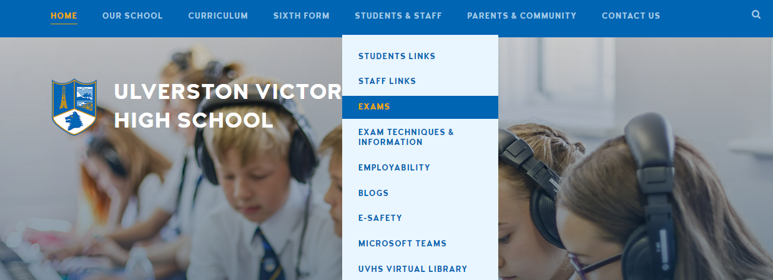
Y10 Exam Week https://www.uvhs.uk/exams/timetable

Slide 10
Year 10 Practice Exams
Familiarisation of the environment and conditions in which external exams take place.
Motivating students to start revision early and practising effective revision strategies.
Improving subject knowledge and identifying topics that need attention.

Slide 11
Exam Regulations –
Understanding the rules
Pupils must be on time for all their exams.
Pupils must not communicate with any other students taking the exam as soon as they enter the exam room.

Slide 12
Exam Regulations –
Understanding the rules
The following MUST NOT be taken into the exam room:
notes/paper/timetables
calculator lids
drinks bottles with labels
potential technological/web enabled sources of information such as a mobile phone, a MP3/4 player, a smartwatch.
a watch

Slide 13
Exam Regulations –
Understanding the rules
Drinks bottles must be transparent, with no labels or volume markers and placed on the floor.
Any pencil cases taken into the exam room must be transparent.
Pupils must write in BLACK ink. Coloured pencils or inks may only be used for diagrams, maps, charts, etc. unless the instructions printed on the front of the question paper state otherwise.

Slide 14
Calculators, Dictionaries and Computer Spell-checkers
Must not be used unless they are told otherwise.
Pupils must bring their own equipment with them and know how to use it.
Equipment for the exams are available in school
£2.50 exam pack - reception
£8.50 calculator - Parentpay

Slide 15
Exam Information – the basics for pupils
Know the dates and times of all exams.
Arrive at least 20 minutes before the start of each exam.
https://www.uvhs.uk/exams/timetable

Slide 16
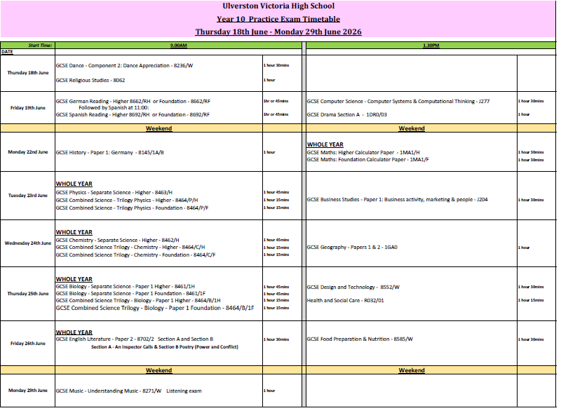
When students do not have exams, they will attend their usual lessons.

Slide 17
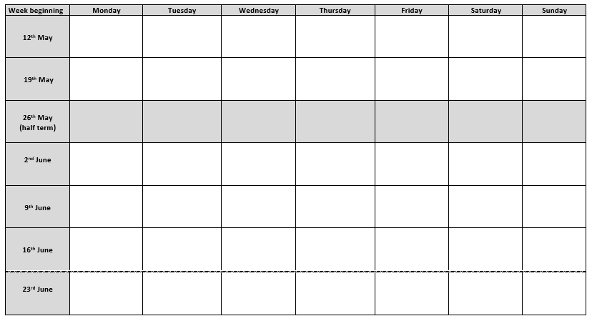
Biology (am)
RS (am)
English (am)
Maths (pm)
Geography (pm)
*Illustration only

Slide 18
Mrs Pirate
How much can you remember?

Slide 19
Soap
Tea
Carrot
Buttons (for coat)
Treasure chest
Onion
Telescope
Eye patch
Vest
Apple Pie
Knickers
Sailing boat
Sea
Parrot (red & green)

Slide 20
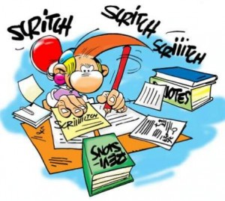
Revision

Slide 21
Top 10 revision tips for students
Start early – don’t keep putting it off
Find the right place to revise
Try different revision techniques
Take short breaks
Eat healthily
Take regular exercise
Get enough sleep
Use revision guides
Don’t just read your notes – write things down
Do lots of practice papers
Notes:
These are the top tem and we can over some of them in more details later. Also in booklet

Slide 22
Ways to revise…
Mindmaps
Index/flash cards
Past papers
Memory skills
Look/cover/write/check
Posters
Record
Games and quizzes
Websites
Group revision
Video/audio
Become a teacher
Notes:
Give more examples later

Slide 23
Mrs Pirate
Spaced recall/retrieval
How much can you remember?
Notes:
Lisa

Slide 24
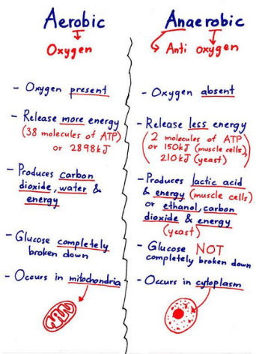
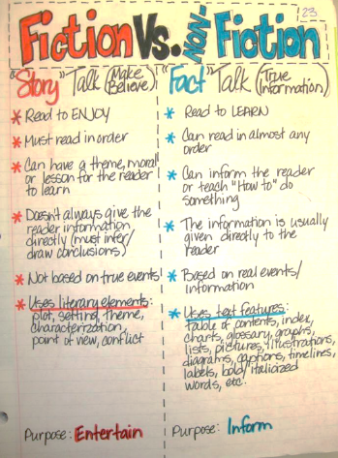
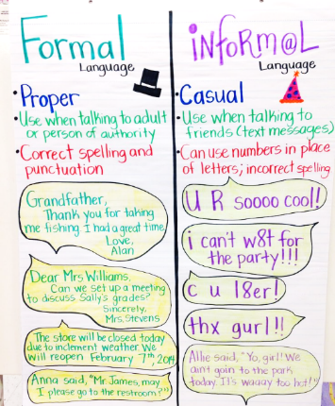

7
Split Page
What?
Help your brain get to grips with an ‘old’ topic by dividing it up to compare key ideas & write simple summaries to help points stick in your mind.
How Use?
Just draw a line down the middle of a page & add clear headings.
Then write simple points using as few words as possible.

Slide 25
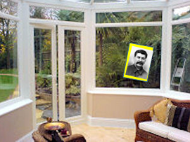
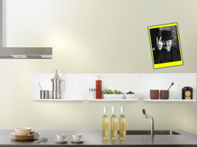
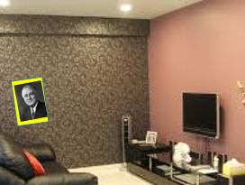
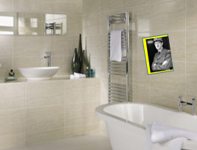
61
Poster Tour
What?
Give your brain some ‘surprise’ stimulation by asking someone to put posters/post-its in random places in your home to create extra ‘memory hooks’.
How Use?
The element of ‘surprise’ can be what your memory recalls first.
That then ‘unlocks’ the words or images that link to a key topic.

Slide 26
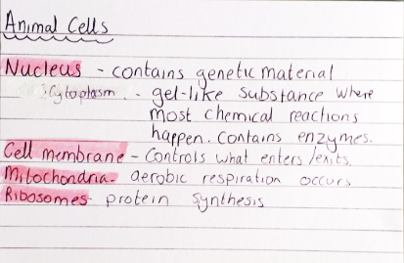
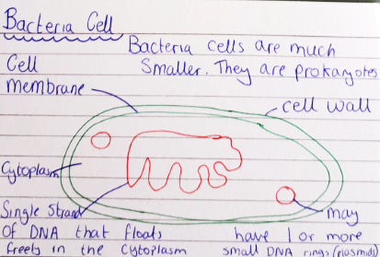
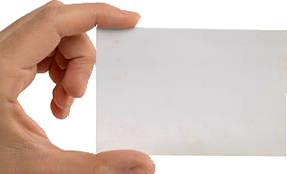
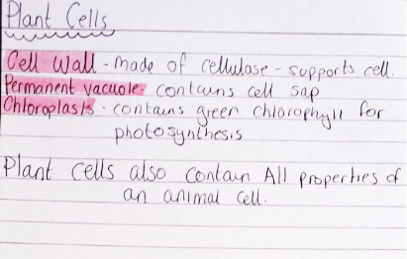

14
Index Cards
What?
Index cards simply carry information and are a great way to make ‘bitesize’ notes about any kind of topic, using words & labelled diagrams
How Use?
First write a clear heading, then keep things clear – don’t cram!
But over weeks & months, keep reading them to refresh your recall
Thanks to some of our Year 11 students for these examples from their ‘reviewing’ notes
Thanks to one of our Year 11 Science students for these sample cards from their ‘reviewing’ notes

Slide 27




72
Walk & Talk
What?
When stuck in a revision rut, a ‘study walk’ can break the boredom & stimulate your brain.
How Use?
Speaking, rather than writing, works better for some people.
So pick a topic & explain it to your walking buddy.
You could even do it when you’re walking the dog but maybe not too loud!

Slide 28
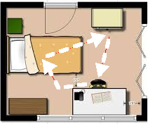
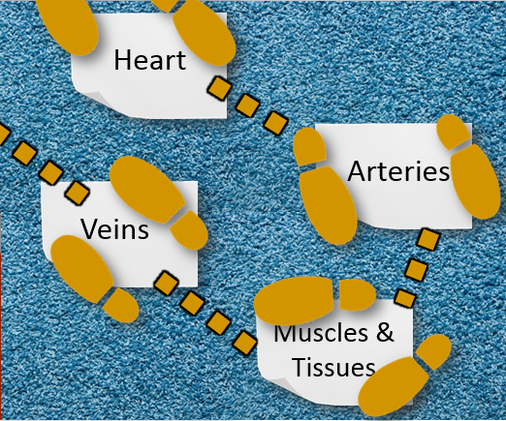
93
Get Moving
What?
Use your room as a way to link actions with ideas to help you remember better.
How Use?
Write key terms on A4 sheets, or post-its & place round room.
Jump, walk or dance (!) between the words and say each out loud.
Movement can help ideas ‘stick’ & it becomes a ‘hook’ for recall later.
Notes:
Good for processes – build the journey in a familiar place (Geography – water cycle)
Good for timelines (History – key dates in chrono order)
Maths - formulae

Slide 29



STRESS
Exercise
Is easier to prevent than to cure.
Be kind to yourself.
Have a soak in the bath.
Do something you know will make you laugh
Notes:
Its normal to feel anxious and stressed about exams. We all deal with stress in different ways. It’s when this stress then has a negative effect
Its normal to feel anxious and stressed about exams. We all deal with stress in different ways.
Keeping talking – make time for them to talk
Possibly expect mood swings and outbursts
Contact school with any issues how ever big or small
Help them keep things in perspective.
Be flexible

Slide 30
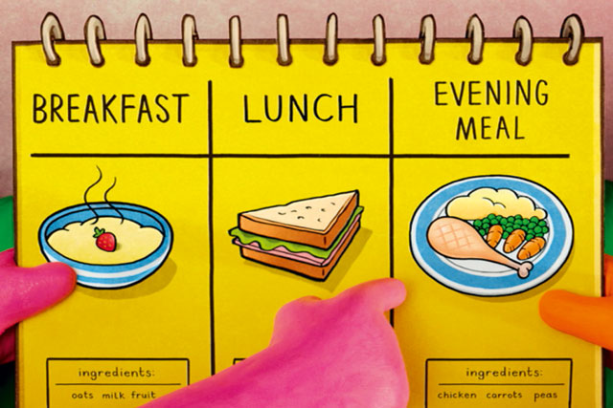


25
Food & Drink
What?
Study habits are important for learning – but your wellbeing is the most important thing so it’s vital to eat & drink healthily
How Use?
It’s all about having a balanced diet, such as having ‘5 A Day’
And it’s crucial to stay hydrated by drinking enough water.
Thanks to some of our Year 11 students for these examples from their ‘reviewing’ notes
For more background on sleep hygiene click here and more on phone ‘blue light’ click here

Slide 31

26
Regular exercise
What?
Being physically active is a huge part of staying mentally active, so that means getting involved in some kind of exercise at school or home
How Use?
It doesn’t have to be sport – just getting out and about is good!
It’s all part of having a healthy work/life balance
Thanks to some of our Year 11 students for these examples from their ‘reviewing’ notes
For more background on sleep hygiene click here and more on phone ‘blue light’ click here

Slide 32
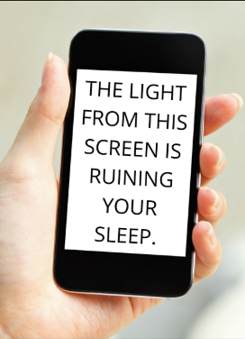
27
Sleep Hygiene
What?
Research reveals that during sleep, the brain finds patterns in our memories from the day and makes them stronger and more permanent.
How Use?
So healthy ‘sleep hygiene’ habits are essential for your wellbeing
Have a regular bedtime & avoid using your phone before bedtime
Thanks to some of our Year 11 students for these examples from their ‘reviewing’ notes
For more background on sleep hygiene click here and more on phone ‘blue light’ click here

