Slide 1

Key Stage 4
Options 2026

Slide 2
Designing a curriculum
National
Government
Local Environment
Needs
of the individual
Balance
Enjoyment

Slide 3
The English Baccalaureate
The EBacc is a performance measure used in school league tables. It is not a qualification in itself but it shows how pupils have achieved across a range of academic subjects –
English, Mathematics, two Sciences, History or Geography and a Modern Foreign Language.

Slide 4
Progress 8
Progress 8 is a performance measure introduced into school league tables in 2016. The measure shows how much progress pupils have made in a range of subjects including the EBacc subjects and up to 3 others. This is also not a qualification in itself.

Slide 5
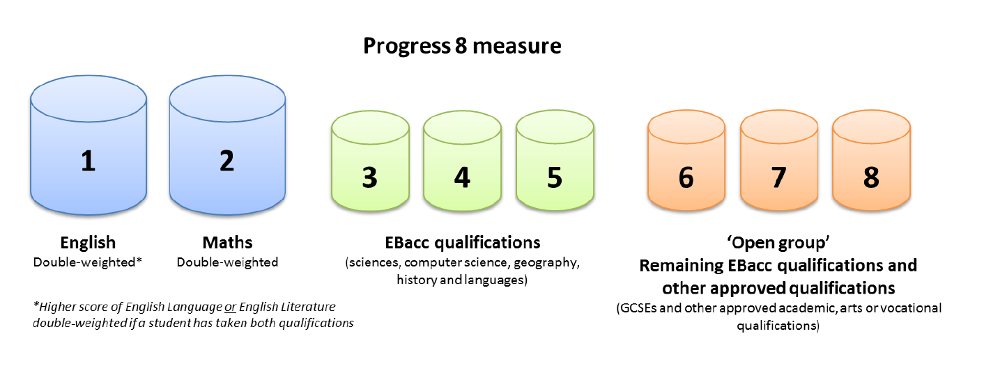


Slide 6
Old Government measure to assess school performance
5 x GCSEs at C or above including English and Maths
New
Progress 8 Score
EBacc Score
English and Maths at Grade 5 and above
Employers and Further Education providers
5 x GCSEs at C or above including English and Maths
New
?

Slide 7
Sixth Form Requirements
Need to achieve a minimum of five grades 9 - 5 including English and Maths.
Sixth Form Prospectus details individual subject requirements. Usually Grade 6 in that subject.
e.g. Maths or French: Grade 6 or above.
Ask subject teachers for their advice.

Slide 8
What is studied at KS4?
COMPULSORY CURRICULUM
This is a fixed set of subjects which the majority of pupils study.
OPTION CHOICES
Four further choices selected from a larger range of subjects.

Slide 9
Compulsory Subjects
English Language
English Literature
Mathematics
Double Science
Personal Development
PE

Slide 10
Option Subjects
Religious Studies (BPE)
Business
Dance
Drama
Music
Fine Art
Food Preparation
Design & Technology
ICT – Creative iMedia
Health and Social Care
Sport Studies
Geography
History
Spanish
German
French
Computer Science
Separate (Triple) Science

Slide 11
Subjects |  | Choices
A | Geography History German Spanish | Choose one subject from Box A
B | Geography History Spanish German French Separate Science Computer Science Dance Drama Music Fine Art Food Preparation Design & Technology Business Religious Studies (BPE) ICT – Creative iMedia Health and Social Care Sport Studies | Choose three subjects from Box B
 |  | Subject | Priority
 |  |  | 1
 |  |  | 2
 |  |  | 3
C | Reserve Choice Please identify an additional subject as your reserve choice | Reserve Subject Choice

Slide 12
Subjects |  | Choices
A | Geography History German Spanish | Choose one subject from Box A
 |  | Geography
B | Geography History Spanish German French Separate Science Computer Science Dance Drama Music Fine Art Food Preparation Design & Technology Business Religious Studies (BPE) ICT – Creative iMedia Health and Social Care Sport Studies | Choose three subjects from Box B
 |  | Subject | Priority
 |  | Creative iMedia | 1
 |  | German | 2
 |  | Drama | 3
C | Reserve Choice Please identify an additional subject as your reserve choice | Reserve Subject Choice
 |  | Fine Art

Slide 13
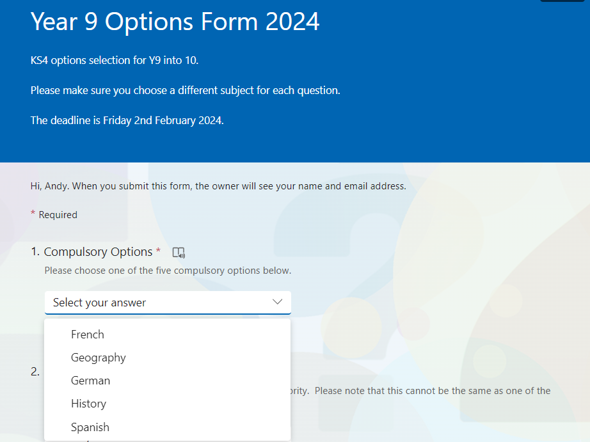
Online Options Form
Link sent to pupil by email
Can only be completed once
Deadline Monday
2nd February

Slide 14
Making Choices
An important step - think carefully.
Difficult to make a serious error about the future.
But it does determine what pupils will do for the next two years.
Keeping doors open!

Slide 15
Making Choices
Breadth and Balance
Range of skills
Enjoyment and Interest
Post-16 Choices
Adaptability

Slide 16
How do pupils decide?
They need to consider these questions:
What am I good at?
What do I enjoy?
What do I need?
Parents
Form teacher
Subject teachers
They need to talk to:

Slide 17
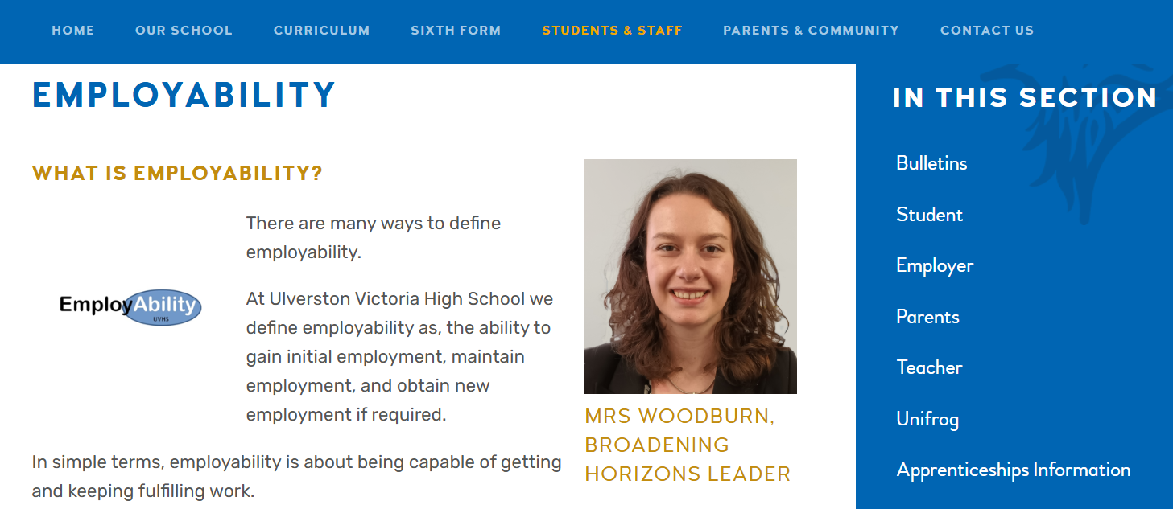
How do pupils decide?
Carry out research:
UVHS Website - Employability

Slide 18
What happens now?
Options Assembly on Monday 12th January
New Subject Assembly on Tuesday 13th January
Information in subject lessons over the next 2 weeks
Options Guide goes home and electronic Options Form available on Wednesday 14th January
Parents’ Evening on Thursday 22nd January
Deadline for Options Form is Monday 2nd February

Slide 19

Website support

Slide 20

Ulverston Victoria High School
Key Stage 4 Options 2026

