Slide 1
How will UVHS support pupils during a closure

Slide 2
REMINDER - How you can stop coronaviruses spreading

Slide 3
REMINDER - How you can stop coronaviruses spreading

Slide 4
How will UVHS support pupils?
Teams will be used in the same way as it currently is for homework.
Assignments will be set to complete each week.
Pupils can complete the work online and receive feedback from their teachers.

Slide 5
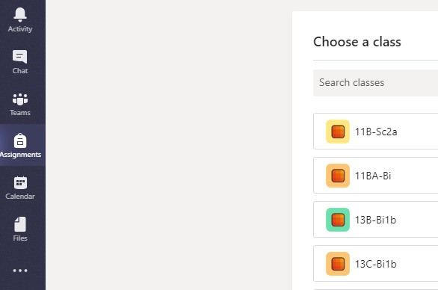
How will UVHS support pupils?
Teams has changed slightly.
Click on Assignments and then choose which class you want to view.
All assignments for that class will then appear on the next page.

Slide 6
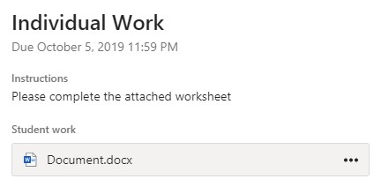
How will UVHS support pupils?
Pupils can work on their own copy of the resource and submit their answers.
There is no need to download the resource, just complete it in the App.
Don’t forget to submit.

Slide 7
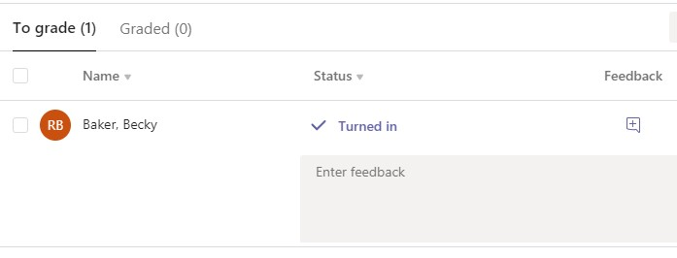
How will UVHS support pupils?
Teachers will be able to see the work and give feedback before setting the next piece of work.

Slide 8
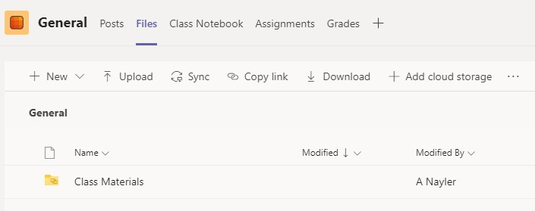
How will UVHS support pupils?
Additional learning resources to help pupils will be added to Files.

Slide 9
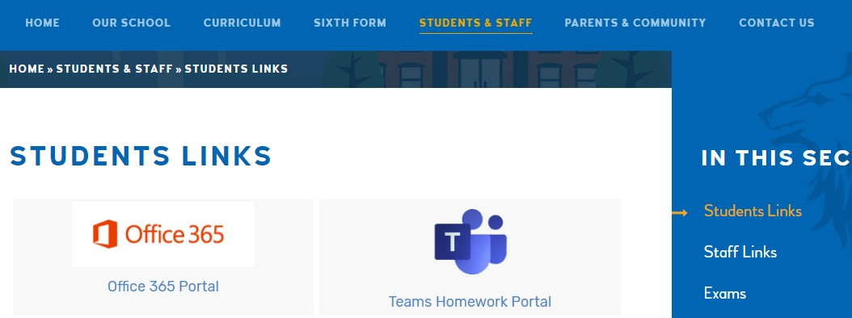
How will UVHS support pupils?
Don’t forget there are lots of extra educational links provided on the school website.

Slide 10
How will UVHS support pupils?
Please note that there may be times when teachers are unwell or are caring for others at home.
We will continue to try our best to support our school community at this difficult time.

